Slide 1


DealOye: An online platform for buying and selling study materials using web development technologies
Guided By: Presented By:
Prof. Shahida Khan Pavendra Singh Rajput (0827IT211081)
Sanjna Yadav (0827IT211104)
Soni Rathore (0827IT211112)
Vidhi Goyal (0827IT211128)
Vikas Agrawal (0827IT21130)

Slide 2
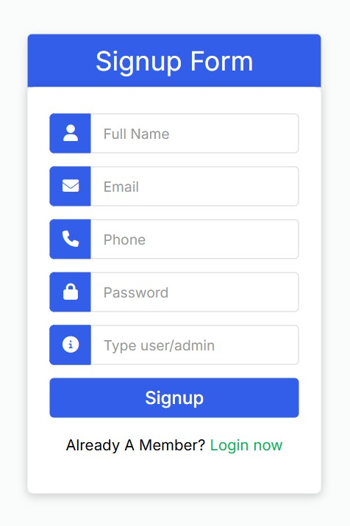
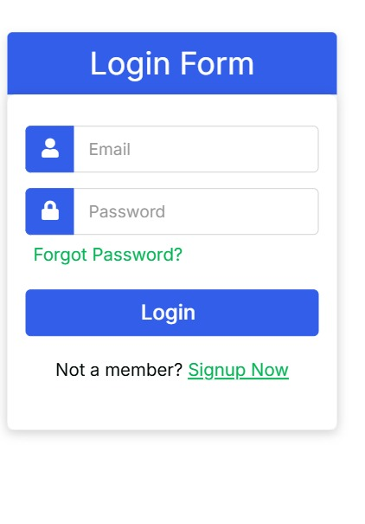
User Interface

Slide 3
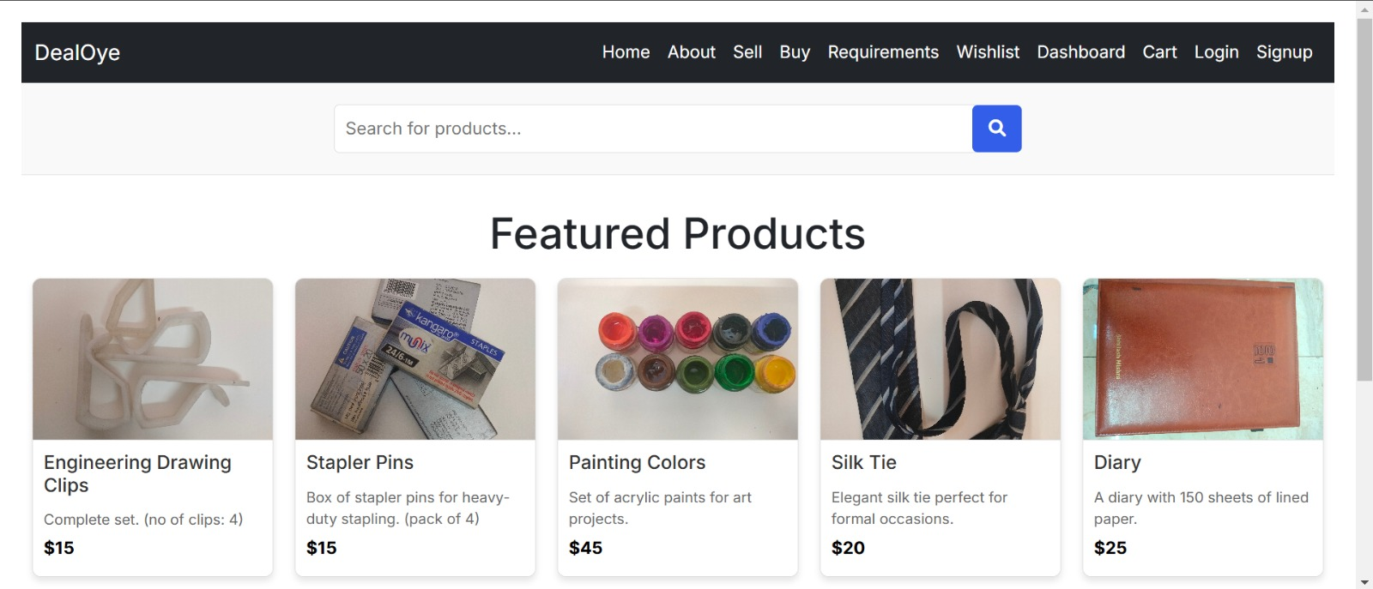

Slide 4
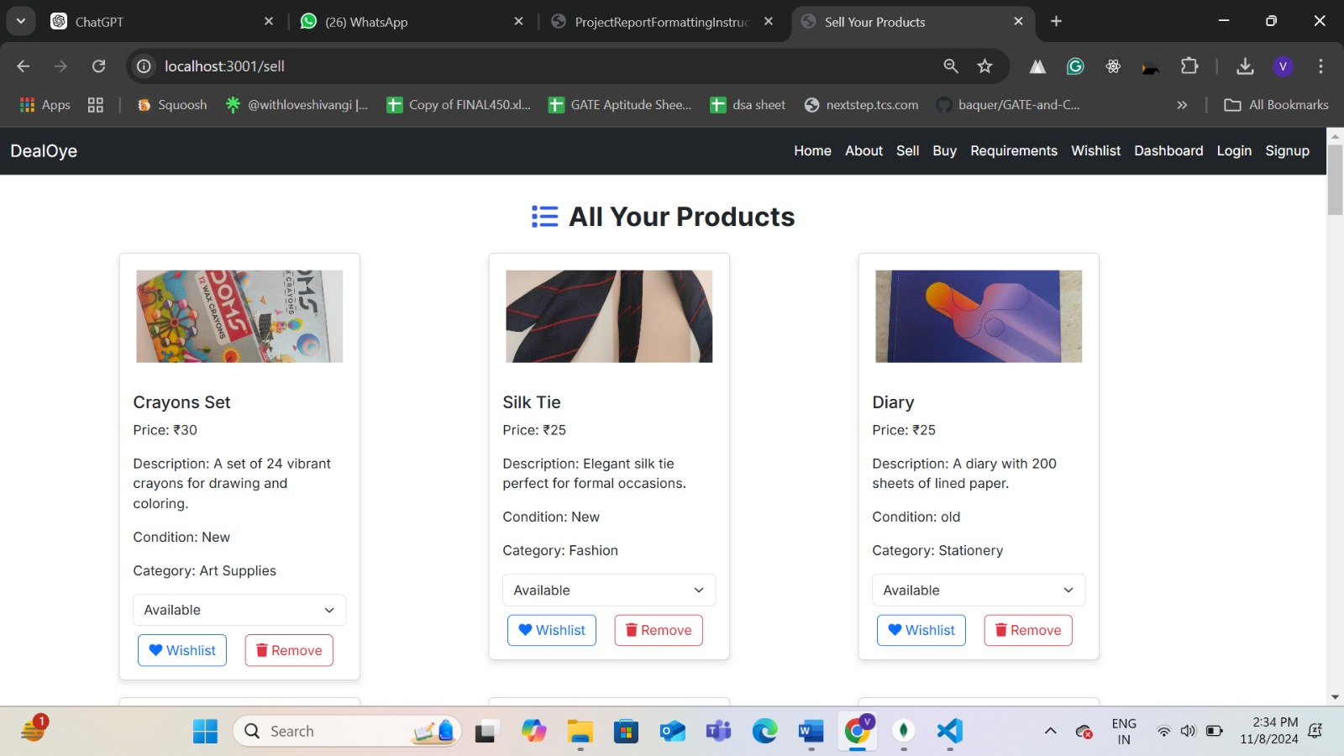
5

Slide 5
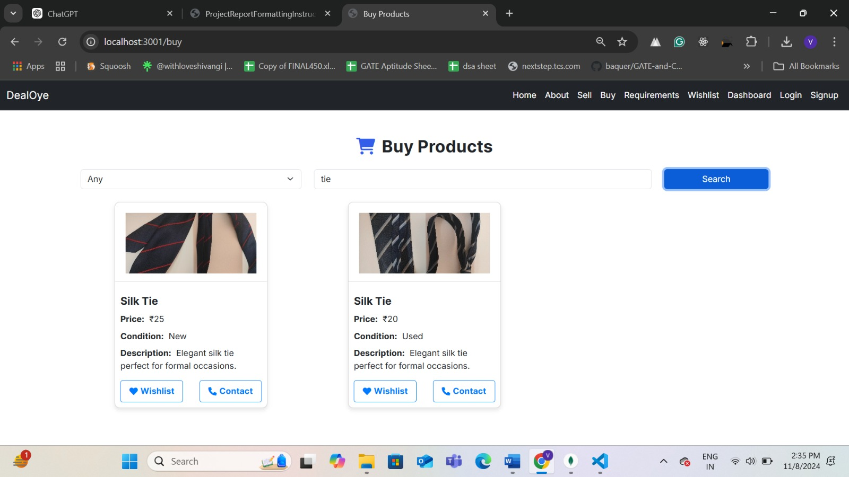

Slide 6
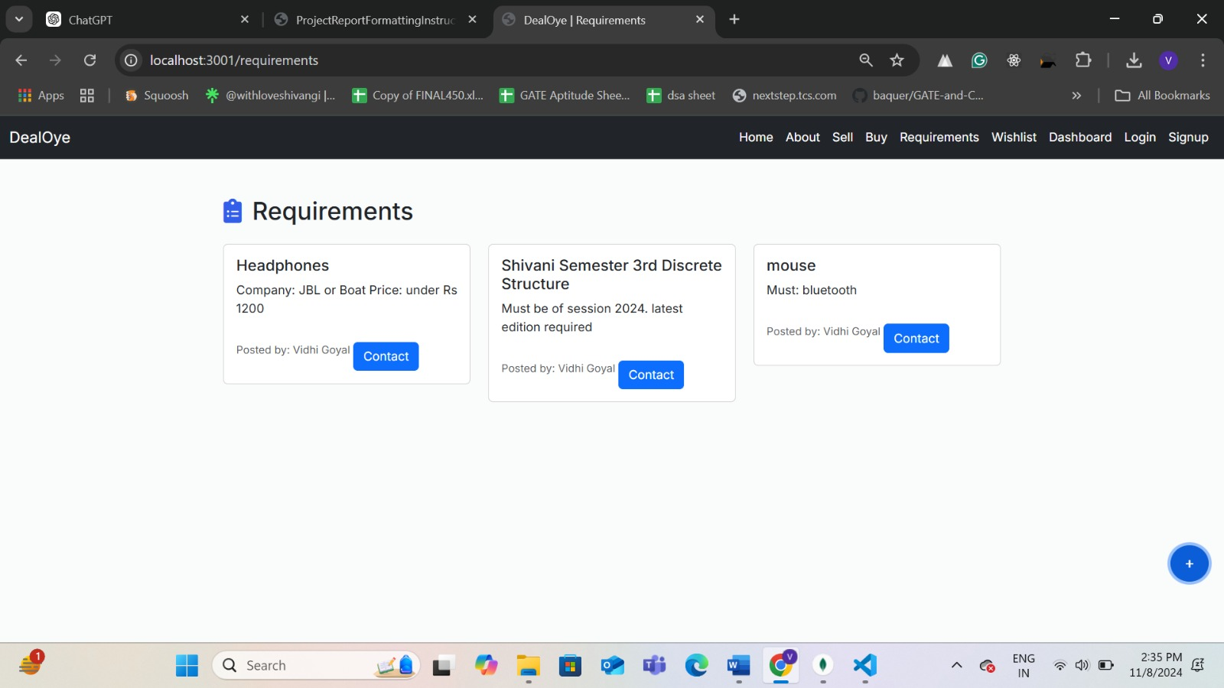

Slide 7
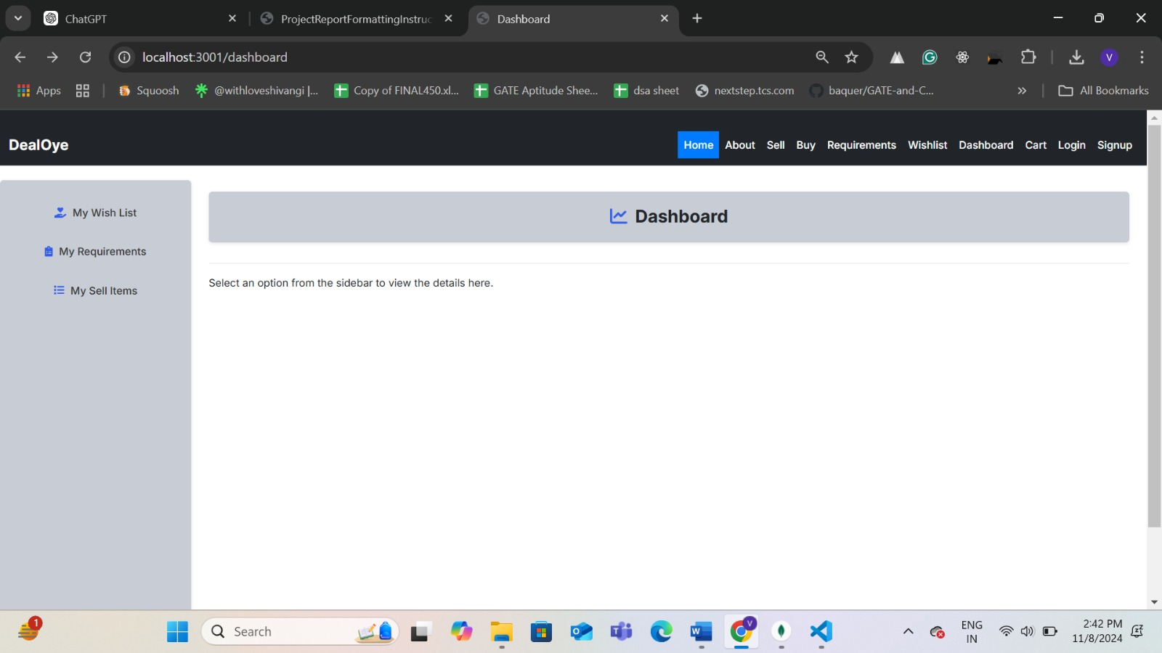

Slide 8
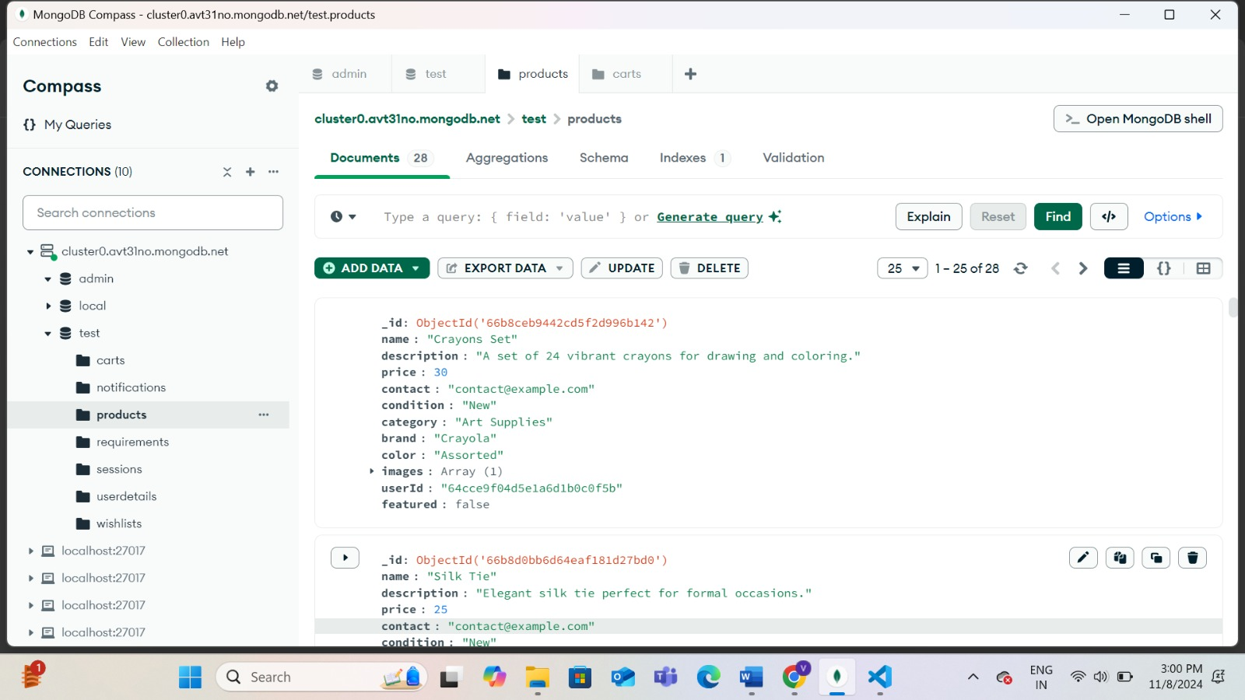
Database Connection

Slide 10
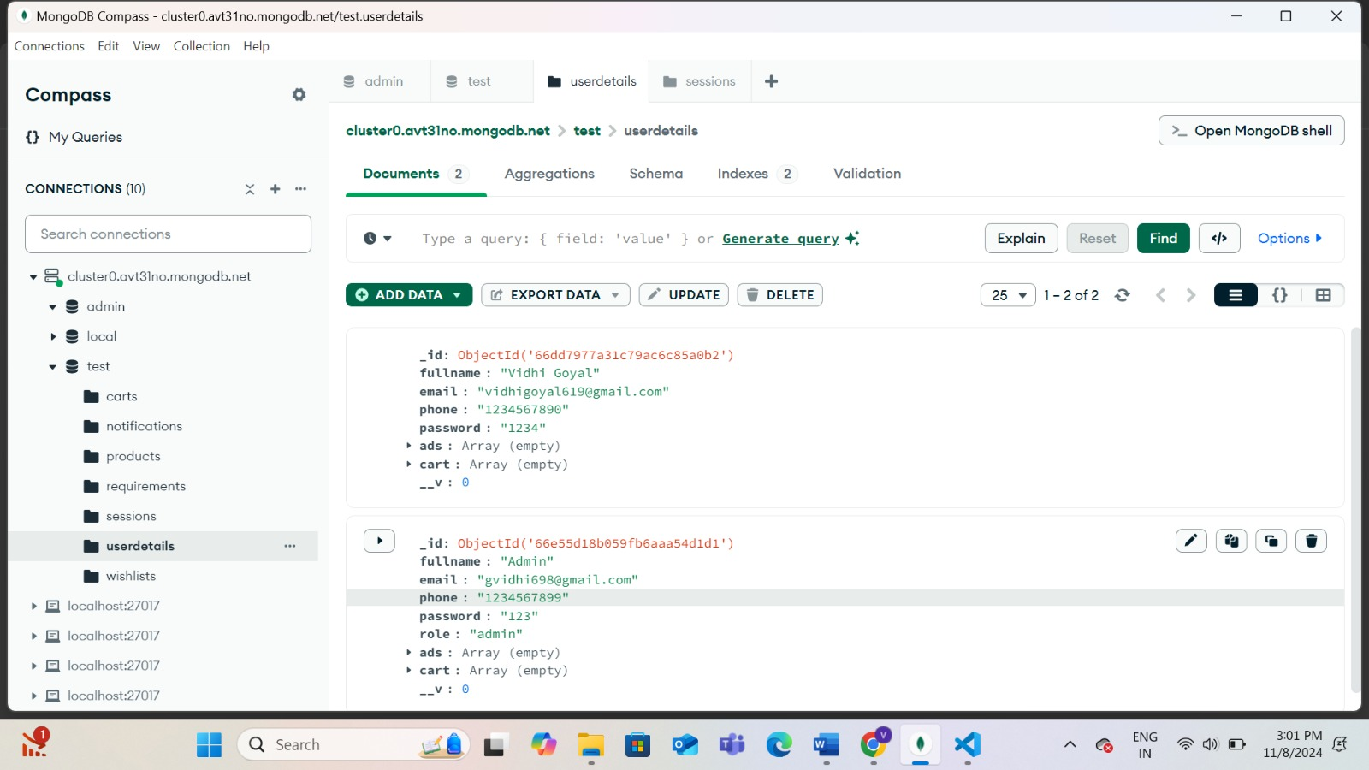

Slide 11
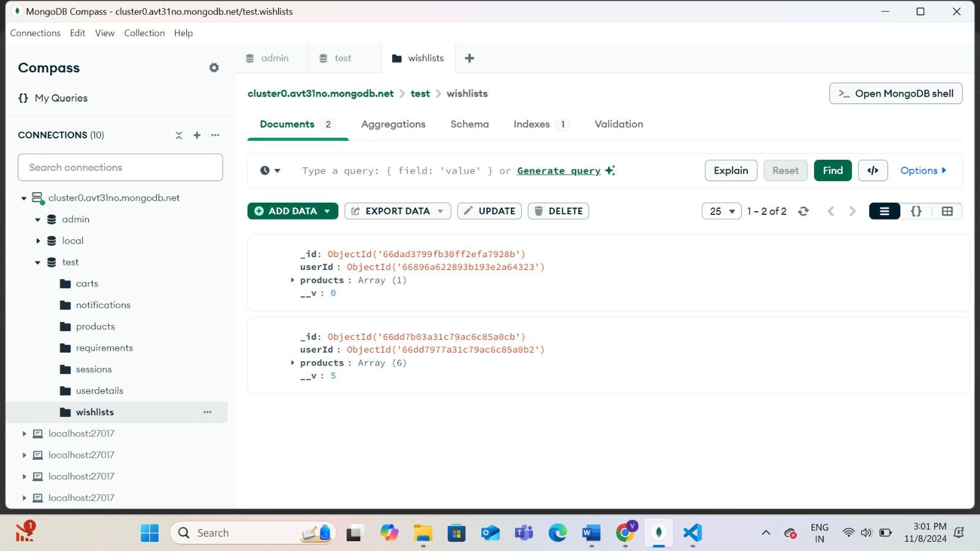

Slide 12
